Slide 1


TerpHire
Online Directory for Smith School Alumni
- Navroze Mishra

Slide 2
Background
This project provides a platform for Employers/Job seekers to offer/view internship and career opportunities.
Every job seeker has a unique ID (user Id) along with other user details like username, email Id, contact details, address, date of birth, GPA, visa, location preference etc.
Similarly, each employer on the portal has a unique employer ID with other details like employer name, industry, website and contact details.

Slide 3
Mission Statement
Terphire is a Business Intelligence tool available to clients for viewing job seekers and employers that offer job and internship opportunities.
It allows the client to generate insights in various dimensions -
Employers side
For example - jobs looking for people having more than 2 years of work experience
Job seekers side
For example - job seekers having job location preference as Washington DC

Slide 4
Mission Objective
Allow the Job Seeker to view all the job/internship postings that they are eligible for.
Allow the Employer to view all the eligible job seekers/applications received that match the criteria for job/internships posting.
Keep a record of the Job Seekers’ complete profile information.
Maintain a record of all applications applied by the job seeker.

Slide 5
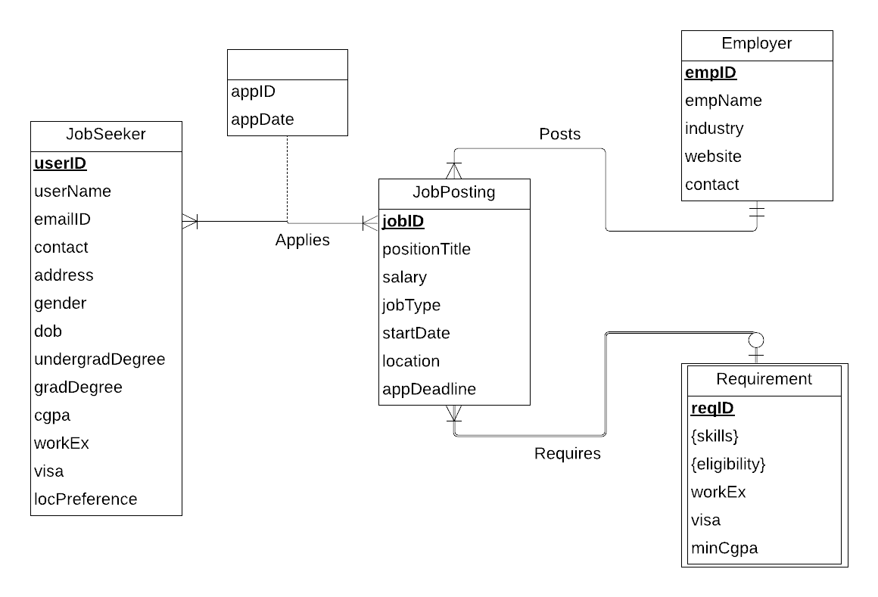
Conceptual Database Design

Slide 6
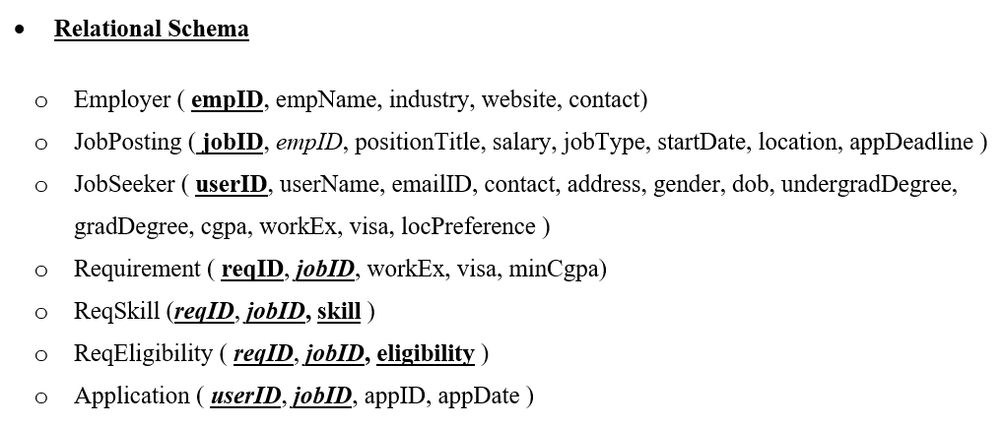
Logical Database Design

Slide 7
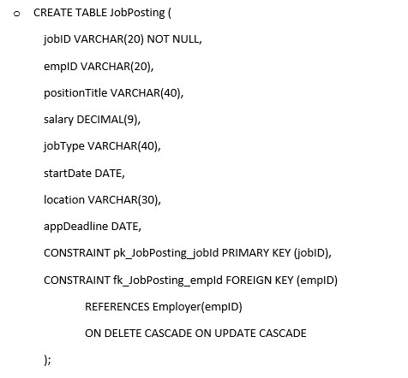
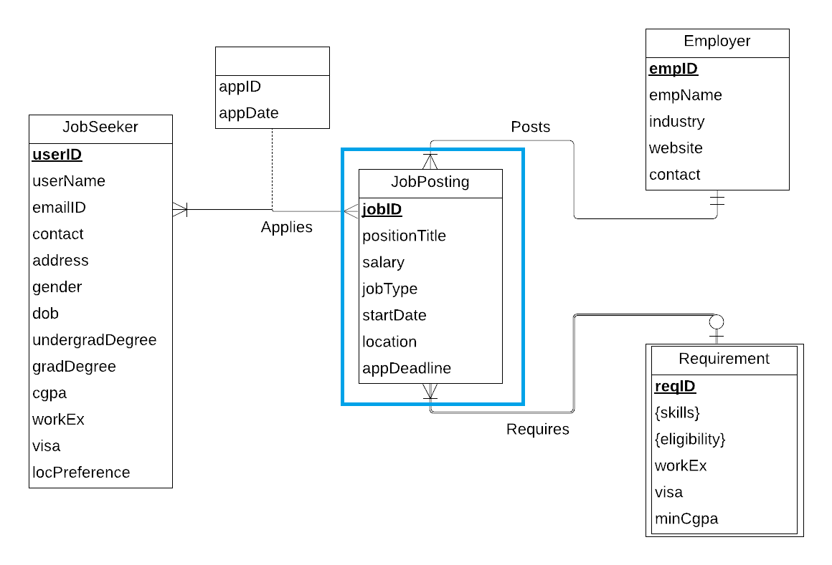
Physical Database Design

Slide 8



Tools Used

Slide 9
Use Case 1 - SELECT Statement
What are the job positions offered by all the employers belonging to ‘Manufacturing’ industry’?
SELECT j.positionTitle, e.empName,e.industry
FROM JobPosting j JOIN Employer e
ON j.empID = e.empID
WHERE e.industry = 'Manufacturing'
ORDER BY empName;

Slide 10
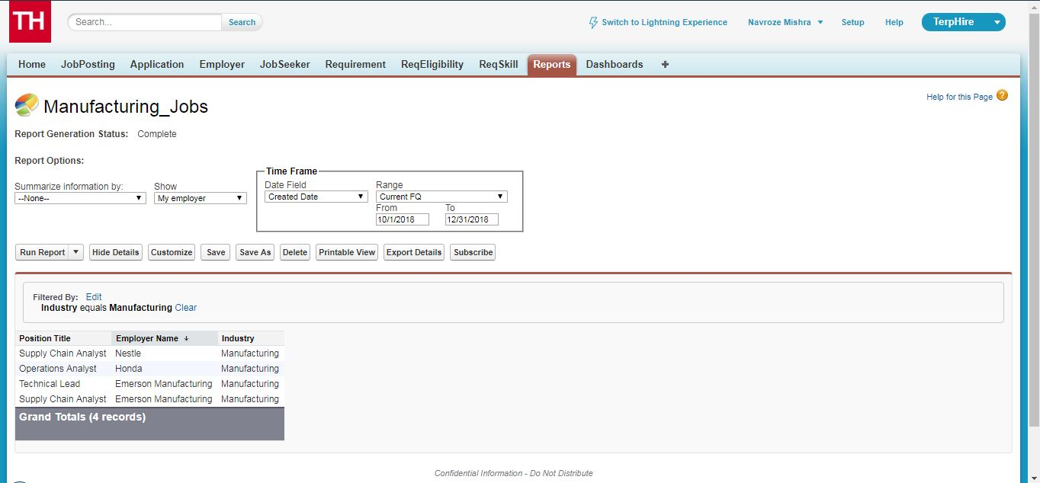
Use Case 1 - Application
What are the job positions offered by all the employers belonging to ‘Manufacturing’ industry’?

Slide 11
Use Case 2 - SELECT Statement
What are the profiles of job seekers who are eligible for jobs with the following requirements in descending order of their GPA ?
Work Experience >= 3 years
Minimum CGPA - 2.8
Visa status - F1
SELECT j.userID, j.userName, j.visa, j.cgpa, j.undergradDegree, j.gradDegree, j.workEx, j.address, j.contact
FROM JobSeeker j
WHERE j.workEx >= 3 AND j.cgpa >= 2.8 AND j.visa = ‘F1’
ORDER BY j.cgpa DESC;

Slide 12
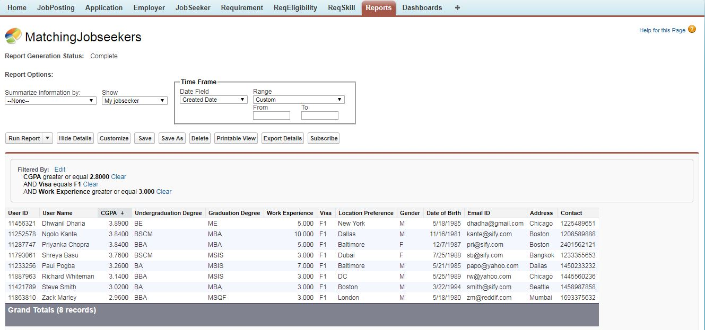
Use Case 2 - Application
What are the profiles of job seekers who are eligible for jobs with the following requirements in descending order of their GPA ? Work Experience >= 3 years, Minimum CGPA - 2.8, Visa status - F1

Slide 13
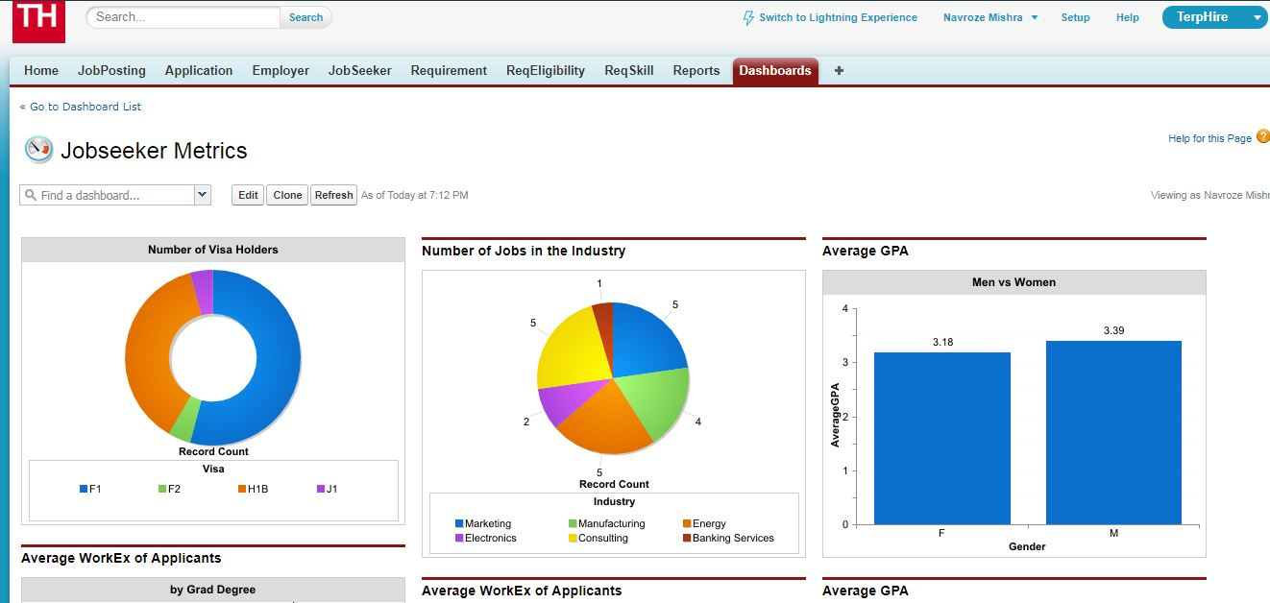
Dashboard View

